Slide 1
EN 204
Material Science for Energy Applications
Class 5
Shaibal K Sarkar
Department of Energy Science and Engineering
shaibal.sarkar@iitb.ac.in

Slide 2
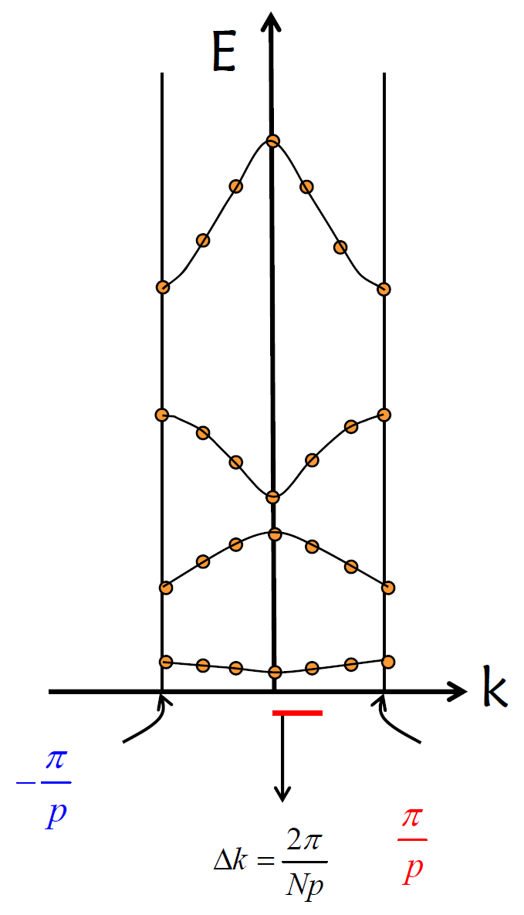
Brief recap
In the last class, we have learnt about determining the electronic band structure by Bloch Function and Kronig Penny Model.
What we are up for today?
We will use the previous mathematical understanding to find the physical interpretation.
Secondly we will determine the electron band diagram in a “real solid” – in addition, we will be familiar with “reciprocal space”

Slide 3
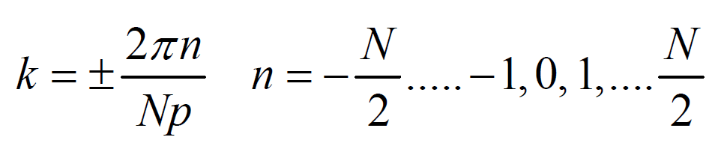
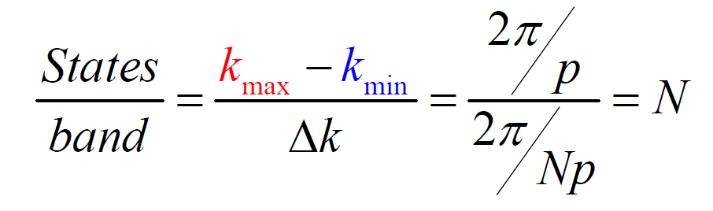
Brillouin Zone and Number of States

Slide 4
Concept Note:
Realization of Effective Mass

Slide 5
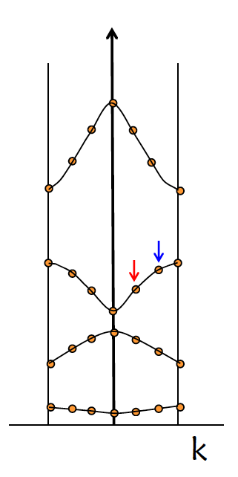
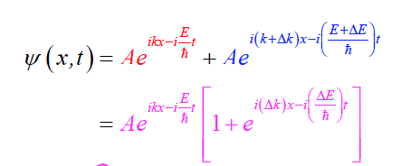
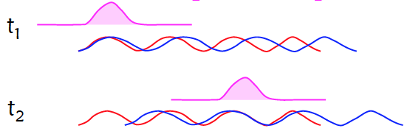
Understanding E-k diagram

Slide 6
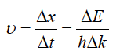
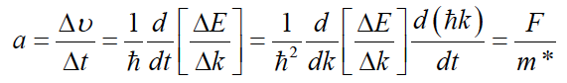
Understanding m*

Slide 7
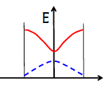
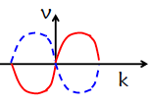
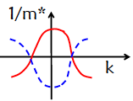
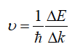
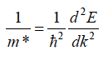
Understanding m*

Slide 8
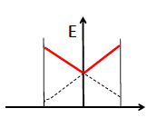
Understanding E-k diagram
If the parabolic bands are replaced by linear relation, then comment at the effective mass of the materials

Slide 9
Concept Note:
Filled and Empty Bands Carry No Current
But
Situation changes upon applied electric field

Slide 10
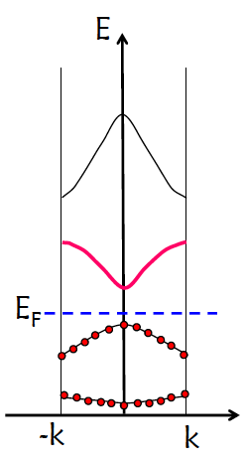
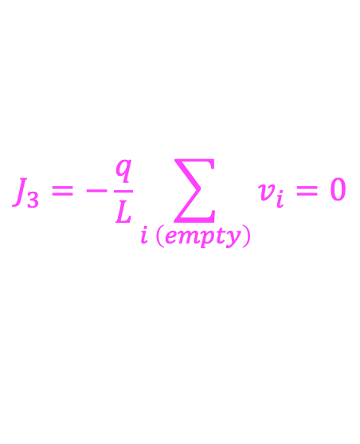
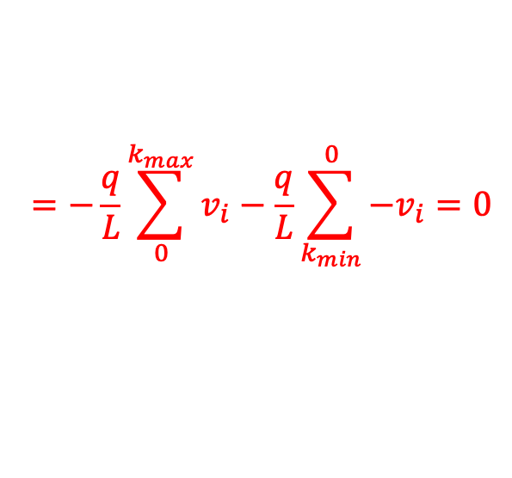
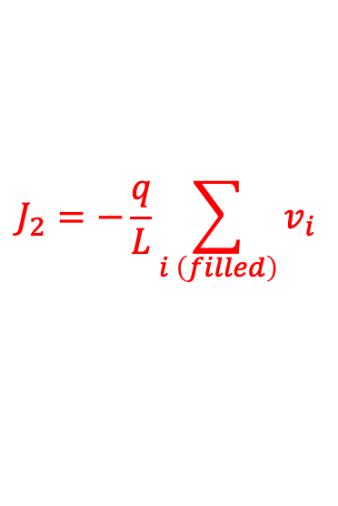
Understanding E-k diagram: Filled and Empty Bands
$$J_{3}=−\frac{q}{L}\sum_{i \left(empty\right)}{v_{i}}=0$$
$$J_{2}=−\frac{q}{L}\sum_{i \left(filled\right)}{v_{i}}$$
$$=−\frac{q}{L}\sum_{0}^{k_{max}}{v_{i}}−\frac{q}{L}\sum_{k_{min}}^{0}{{−v}_{i}}=0$$
Filled and Empty Bands Carry No Current
What about a partially filled band?
What about an electric field?

Slide 11
Understanding E-k diagram: Filled and Empty Bands
Ε
k
k
k
k_{min}
k_{max}
k_{min}
k_{max}
k_{min}
k_{max}

Slide 12
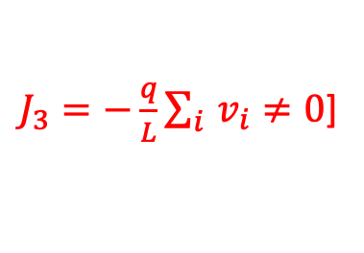
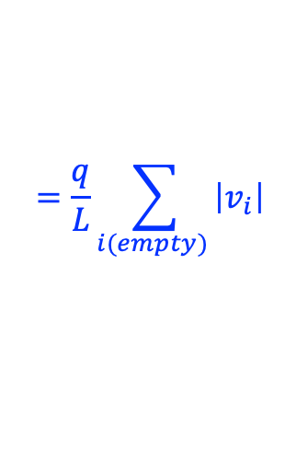
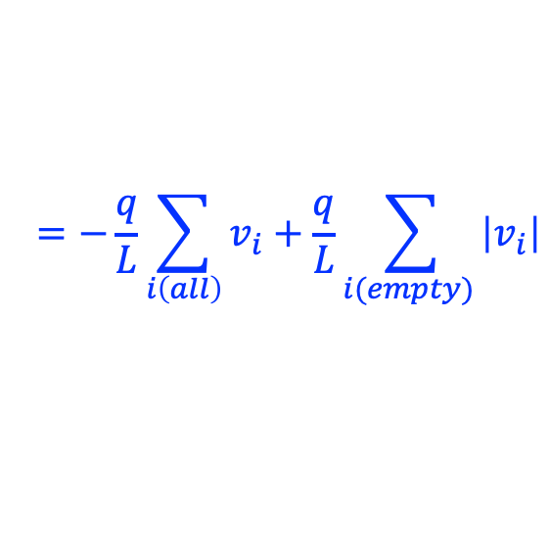
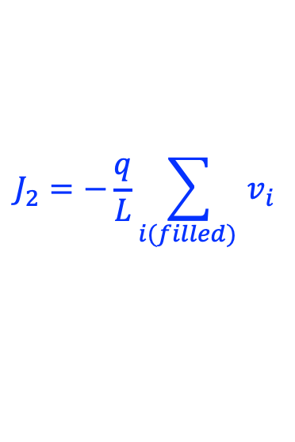
Understanding E-k diagram: Filled and Empty Bands
$J_{3}=−\frac{q}{L}\sum_{i }{v_{i}}≠0$]
0
$$J_{2}=−\frac{q}{L}\sum_{i(filled) }{v_{i}}$$
$$=−\frac{q}{L}\sum_{i\left(all\right)}{v_{i}}+\frac{q}{L}\sum_{i(empty) }{\left|v_{i}\right|}$$
$$=\frac{q}{L}\sum_{i(empty) }{\left|v_{i}\right|}$$

Slide 13
Back to E-k diagram

Slide 14
Determining the E-k diagram
For free electron the E and k_{x} relation can be written as
Applying Bloch function in Periodic Potential:
P = 0

Slide 15
Determining the E-k diagram for free electron
E
k

Slide 16
Determining the E-k diagram for free electron
E
k
0

Slide 17
Determining the E-k diagram for free electron
E
k
0

Slide 18
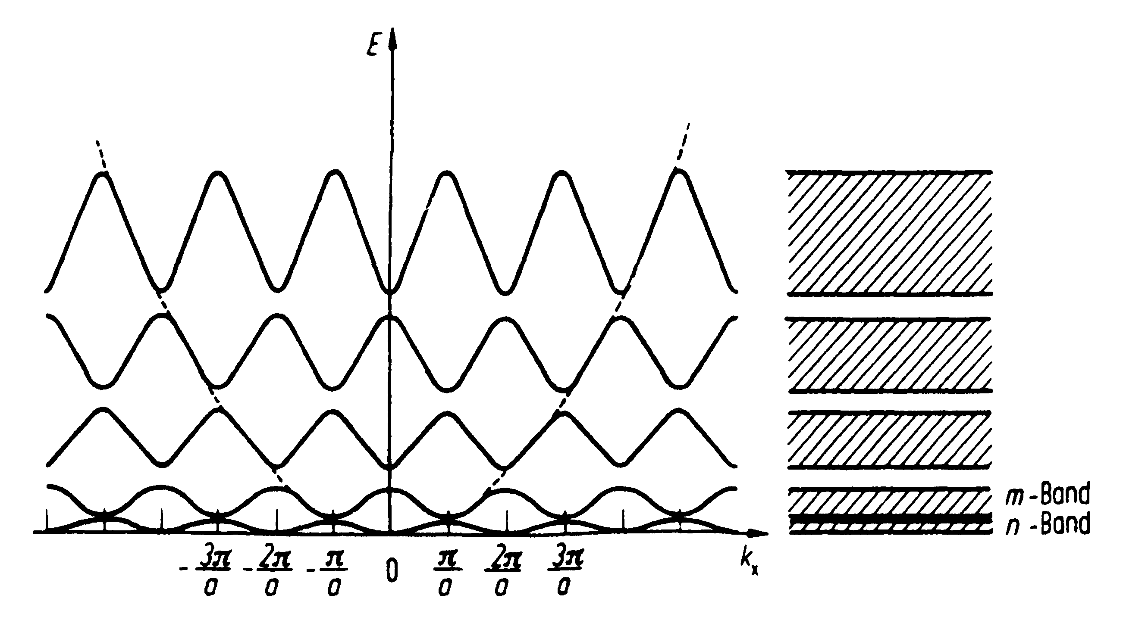
Determining the E-k diagram in periodic potential

Slide 19
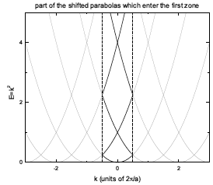
Determining the E-k diagram in periodic potential

Slide 20
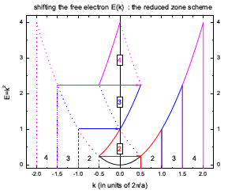
Determining the E-k diagram in periodic potential

Slide 21
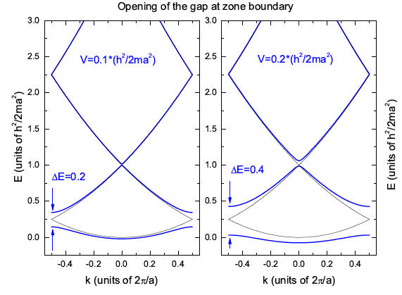
Determining the E-k diagram in periodic potential

Slide 22
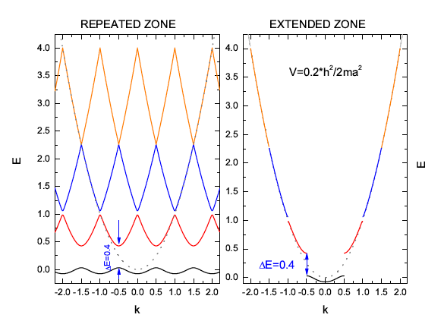
Determining the E-k diagram in periodic potential

Slide 23
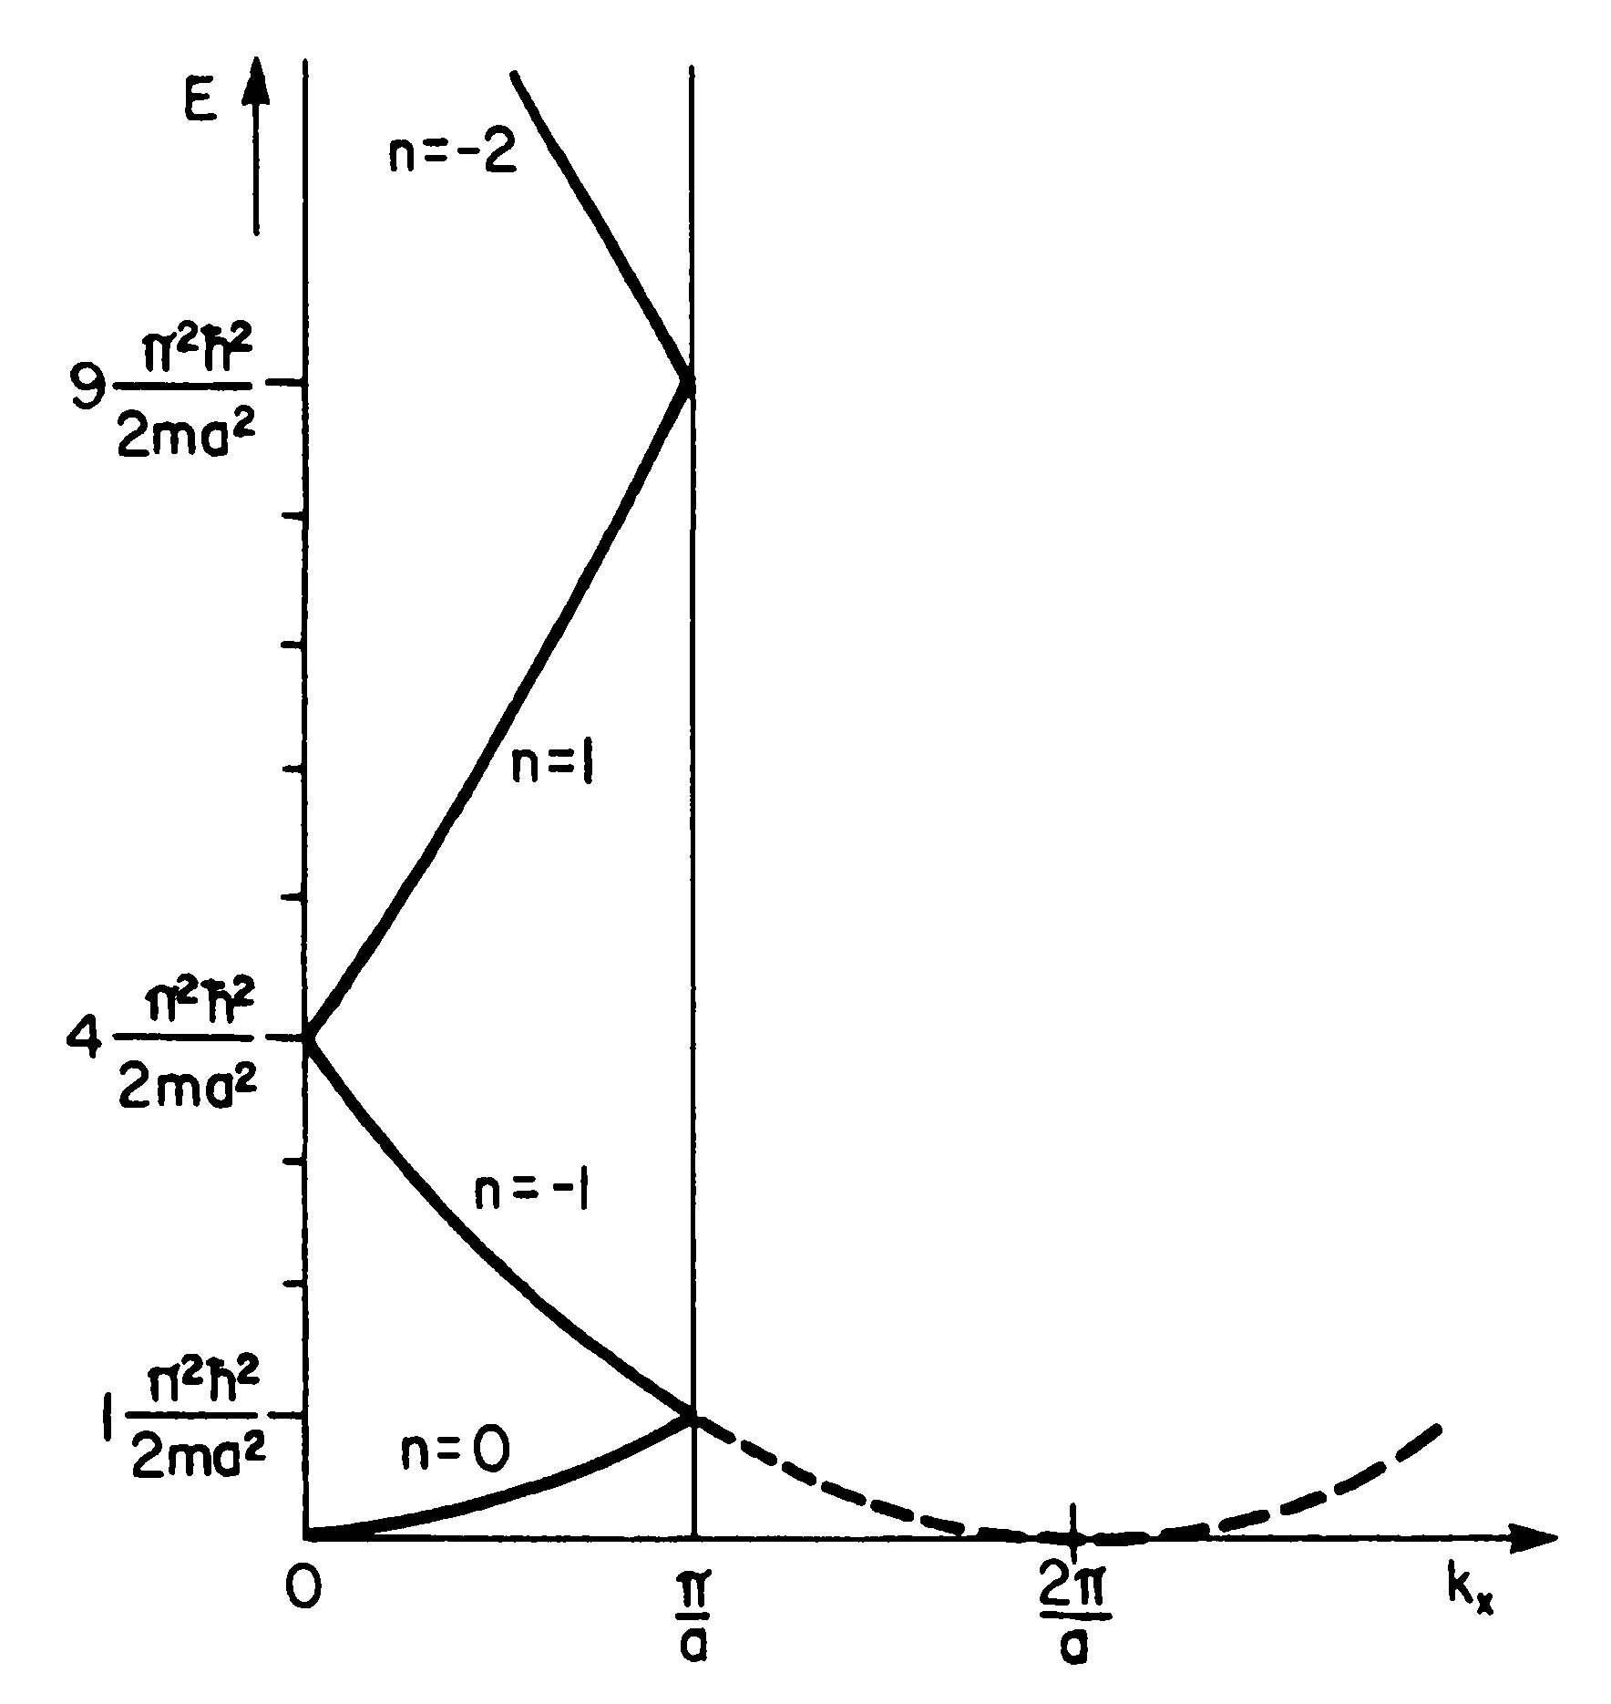
Free electron band diagram
From the Bloch function in Periodic Potential:

Slide 24
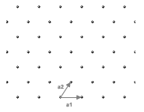
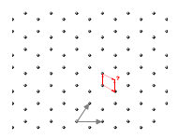
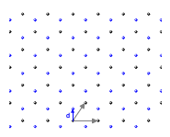
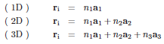
A detour : Understanding the crystal

Slide 25
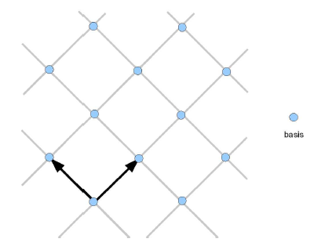
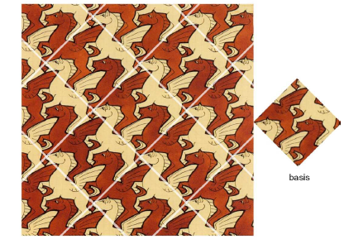
A detour : Understanding the crystal

Slide 26
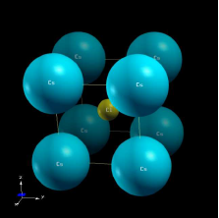
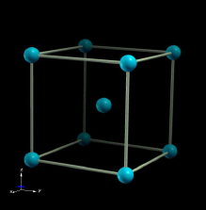
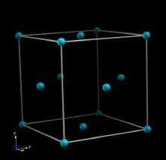
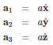
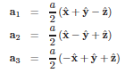
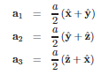
A detour : Understanding the crystal

Slide 27
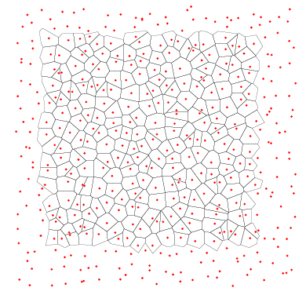
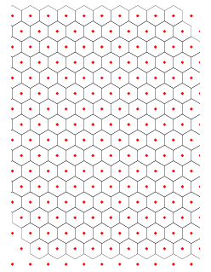
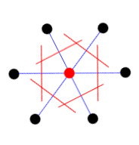
A detour : Understanding the crystal

Slide 28
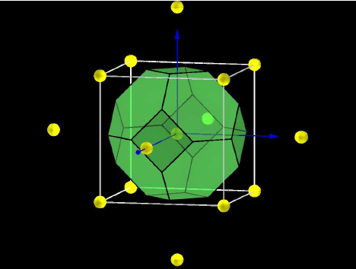
A detour : Understanding the crystal

Slide 29
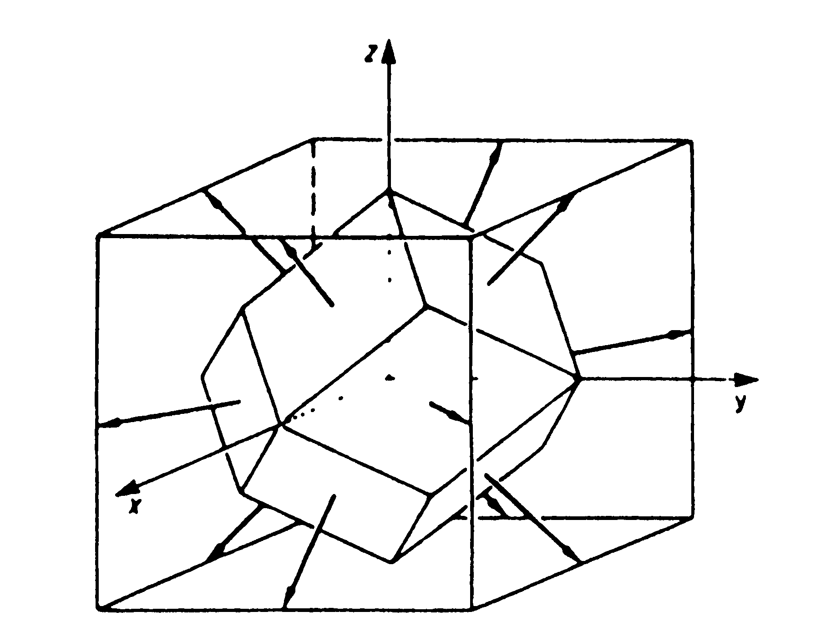
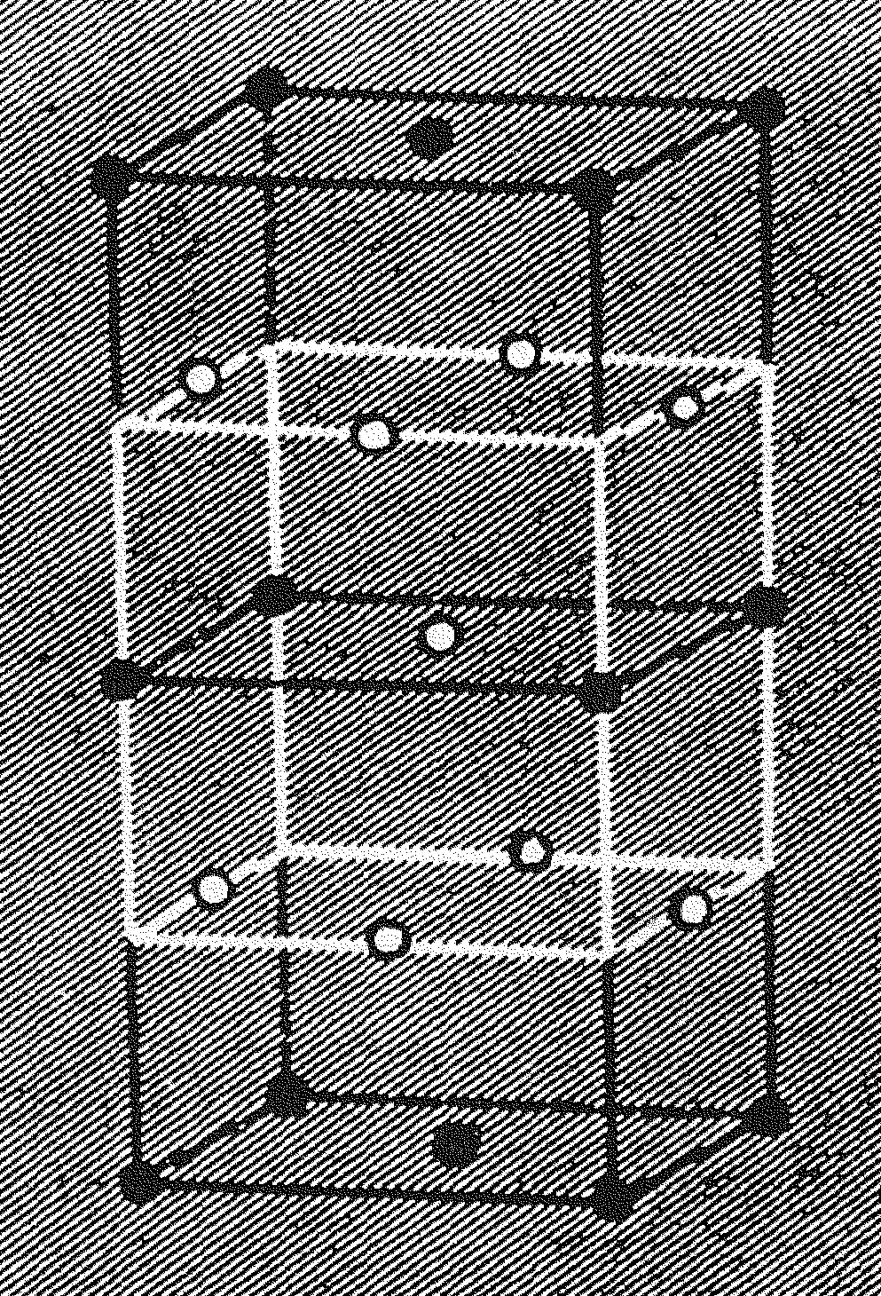
A detour : Understanding the crystal

Slide 30
Reciprocal Space
If t1, t2 and t3 are the three fundamental vectors that are inserted in the primitive cubic lattice, then the translation vector can be defined as
n1, n2 and n3 are the integers
In reciprocal space three fundamental vectors; b1, b2 and b3 can also form a translation vector that can be written as
h1, h2 and h3 are the integers

Slide 31
Reciprocal Space
By the definition of the reciprocal space, the scalar product of t1 and b1 will be unity only

Slide 32
Reciprocal Space

Slide 33
Reciprocal Space

Slide 34
Reciprocal Space

Slide 35
Reciprocal Space

Slide 36
Reciprocal Space

Slide 37
Reciprocal Space

Slide 38
Reciprocal Space

Slide 39
The task ahead Understand electron distribution in bands

